Slide 1
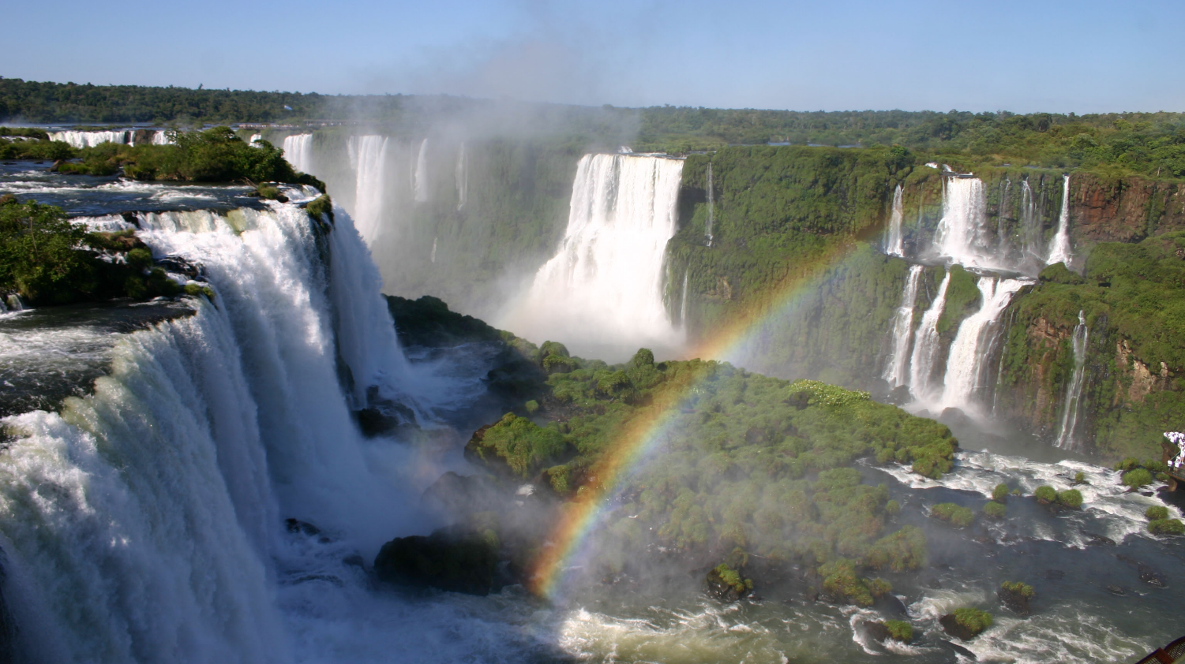
Transboundary Conservation Areas
Lesson 8: Final Thoughts
Notes:
Photo Credit: Iguazu Falls (Brazil) ©IUCN / Boris Erg
*Note that all of the photos in this presentation are of the Iguazu Falls, shared by Brazil and Argentina.
Context and purpose of Lesson 8
This is the final lesson in this module on initiating transboundary conservation. The purpose is to:
Provide an overview of the next steps in transboundary conservation process
Provide final thoughts on initiating transboundary conservation
Give learners a final opportunity to ask questions or raise points for discussion
Supplemental Reading
IUCN WCPA Best Practice Guidelines Transboundary Conservation: A systematic and integrated approach (Pgs.70– 82)
IUCN Initiating effective transboundary conservation: a practitioner’s guideline based on the experience from the Dinaric Arc (Pgs. 24–41)
IUCN Guidelines for Protected Areas Legislation (PA Guidelines) (Pgs. 270–271, 280–292)

Slide 2
Factors of Success
Assess the enabling environment to pursue transboundary conservation
Define the transboundary context and relationships affecting the achievement of the conservation targets and the resulting geographic extent
Identify and involve stakeholders, obtain support of decision makers and ensure political will and buy-in
Agree on common values and joint vision
Determine common transboundary management objectives and develop cooperative agreements
Notes:
Photo credit: Iguazu Falls (Brazil) ©IUCN / Boris Erg
Factors of success
Recall the five factors of success in the process of initiating transboundary conservation:
1. Assess the enabling environment to pursue transboundary conservation
2. Define the transboundary context and relationships affecting the achievement of the conservation targets and the resulting geographic extent
3. Identify and involve stakeholders, obtain support of decision makers and ensure political will and buy-in
4. Agree on common values and joint vision
5. Determine common transboundary management objectives and develop cooperative agreements
This module has provided information and practice to ensure participants have the skills and knowledge to achieve these five factors in initiating transboundary conservation. This lesson provides an overview of the next steps, additional thoughts and recommendations, and a final opportunity for questions and discussion relating to all five factors.

Slide 3
Lesson Overview & Goals
Final thoughts
Next steps in transboundary conservation
Lessons and advice in initiating transboundary conservation
Notes:
Photo Credit: Iguazu Falls (Brazil) ©IUCN / Boris Erg
Content overview
This lesson will address:
Next steps in transboundary conservation
Lessons and advice in initiating transboundary conservation

Slide 4

What Comes Next?
Inputs and Processes
Outputs and Outcomes
Take action: Secure resources and implement actions
Assess the capacity to implement plans
Develop an action plan
Secure financial resources
Implement the plans
Evaluate: Learn and adapt
Assess progress and outcomes
Determine if there is a need to continue
Adapt the management and action plans
Communicate progress
Notes:
What comes next?
Establishment and management of transboundary conservation initiatives requires:
Securing capacity needed to implement activities, as well as securing political buy-in and building legitimacy
Developing an action plan
Assessing and securing financial sustainability
Implementation of the management/action plans, including mechanisms for the establishment of transboundary agreements
Monitoring and Evaluation
Assessing progress and outcomes
Determine if there is a need to continue
Adapt the management and action plans
Communicate progress

Slide 5
Securing Capacity
Securing Commitments and Capacity
Secure commitments by stakeholders:
  Knowledge and expertise
  Resources
  Management obligations
Requires regular and consistent dialogues with stakeholders in the planning and management process to gain advice, build confidence and commit resources
Notes:
Photo Credit: Iguazu Falls (Brazil) ©IUCN / Boris Erg
Securing capacity
What comes next?
Securing Capacity
commitments of expertise, knowledge, management obligations and resources by relevant stakeholders
requires regular and consistent dialogues with stakeholders in the planning and management process to gain advice, build confidence, and commit resources

Slide 6
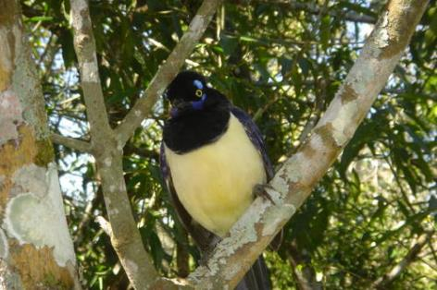
Securing Political Buy-in & Building Legitimacy
Legitimizing transboundary conservation initiatives
Political commitments from prospective countries to begin the dialogue
Building political support and commitment
Sustained collaboration between partners
Balance of local and national involvement
Approaches
Top-down
Bottom-up
Third party facilitation
Notes:
Photo Credit: Iguazu National Park (Argentina) ©UNESCO / Ron Van Oers
Securing political buy-in & building legitimacy
What comes next?
Building Legitimacy
Approaches:
Top-down approach: initiated by institutions and actors who operate at higher levels in governments, regional or international institutions
Bottom-up approach: building transboundary cooperation from the ground level through local communities
Third party facilitation usually brought about through the intervention of a donor, an externally-based NGO or a similar agency
Political commitments from prospective countries to begin the dialogue
Building political support and commitment
Sustained collaboration between partners
Balance of local and national involvement

Slide 7
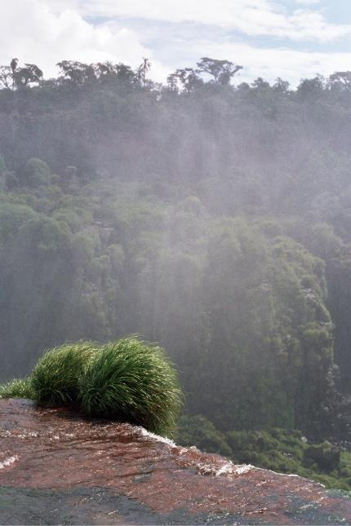
Developing Transboundary Agreements
Approaches
Formal agreements
Informal agreements
Combination of both formal and informal agreements
Notes:
Photo Credit: Iguazu Falls (Brazil) ©IUCN / Boris Erg
Developing transboundary agreements
What comes next?
Development of transboundary agreements
Types of International Agreements: binding, non-binding, and informal
Approaches:
Formal binding agreements should be pursued in patrticular if (1) the relations between parties in the countries are hostile, (2) existing national laws hinder cooperation, (3) governments do not have a strong and long history of collaboration and (4) significant legal, socio-cultural, ecological and economic differences exist.
Informal agreements are generally easier to negotiate and implement. These agreements aid in building cooperative relations and are best used where formal agreements are ineffective.

Slide 8
Developing and Implementing an Action Plan
Identifying the team to oversee implementation
Developing an Action Plan
Developing short-term statements of operational goals derived from long-term management objectives
Must be consistent with each country’s managing procedures
More detailed in delegating tasks, individuals accountable and time frames
Flexible and include proposals for regular review and updating
Notes:
Photo Credit: Iguazu Falls (Brazil) ©IUCN / Boris Erg
Developing and implementing an Action Plan
What comes next?
Development and implementation of an Action Plan
Identifying the team to oversee implementation
Officials and/or representatives with relevant responsibilities, authority to make decisions, and that are accountable for implementation.
Developing specific short-term statements of operational goals, derived from long-term management objectives in the management plan or other higher level document
Goals should be specific, measurable, achievable, realistic and time-bound
Development of Action Plans
Must be consistent with each country’s managing procedures
More detailed in delegating tasks, individuals accountable, and time frames.
flexible documents and include proposals for regular review and updating

Slide 9
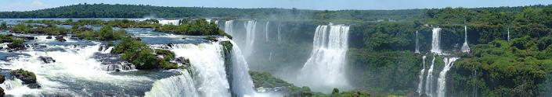
Securing Financial Stability
Recommendations
Review all costs associated with implementation
Assess the full potential of ecosystem goods and services
Identify the beneficiaries and their linkages to the area
Identify strategies relevant to beneficiaries
Secure long-term investments
Design a long-term business plan that compares the costs of joint management of with income generating potential
Locate and acquire alternative funding
Obstacles
Lack of government support
Lack of trust
Lack of capacity
Limited public awareness & understanding of local cultural, ecological, and other values
Incoherent and uncoordinated funding strategies
Funding limited to specific issues
Development of donor-dependency
Notes:
Photo Credit: Iguazu Falls in Misiones (Argentina) ©Martin St-Amant –Wikipedia (CC-by-SA-3.0)
Securing financial stability
What comes next?
Securing Financial Stability
Common Obstacles
Lack of government support
Lack of trust
Lack of local capacity
Limited public awareness
Lack of understanding of cultural, ecological and other values associated with transboundary areas
Incoherent and uncoordinated funding strategies
Funding limited to particular issues, problems
Incompatible legal and policy arrangements across adjacent jurisdictions
Lack of capacity to understand how transboundary conservation initiatives can have ecosystem goods and services can be strategically important for social or economic aspirations.
Development of a ‘donor-dependency’ culture
Recommendations
Review all costs associated with implementation and management for economic efficiency
Assess the full potential of ecosystem goods and services
Identify the beneficiaries and their linkages to the area
Identify strategies relevant to beneficiaries
Secure long-term investments to manage the TBCA
Design a long-term business plan rich compares the costs of joint management of the TBCA with potential income generating opportunities
Locate and acquire alternative funding sources

Slide 10
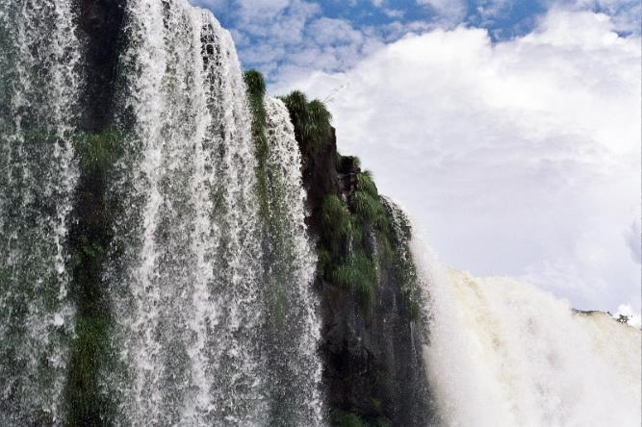
Measuring Results: Monitoring and Evaluation
Monitoring and evaluation provide the intelligence needed to assess results and identify what modifications may be needed to improve performance
Monitoring and Evaluation of TBCA Management Effectiveness
Assess progress and outcomes
Determine if there is a need to continue
Adapt management and action plans
Communicate progress
Notes:
Photo Credit: Iguazu Falls (Brazil) ©IUCN / Boris Erg
Measuring results: Monitoring and evaluation
What comes next?
Monitoring and Evaluation of transboundary management effectiveness
Monitoring and evaluation is an integral part of the conservation planning and management cycle
Provides intelligence to assess results and identify what modifications may be needed to improve performance
For TBCAs:
Assess progress and outcomes – need systems that can work across boundaries and can be applied by countries working together
Determine if there is a need to continue – ask whether there is a compelling reason to continue the transboundary activity, revisiting original goals and objectives (Note that ‘compelling reason to act’, as defined in Glossary, indicates a reason or motive that is convincing enough to undertake transboundary conservation and engage in transboundary cooperation)
Adapt management and action plans – assess changing conditions and adapt relevant objectives and plans
Communicate progress – notify all stakeholders about whether outcomes have been met

Slide 11
Lessons and Advice
Final thoughts on initiating transboundary conservation
Diagnose the situation before engaging in transboundary conservation and decide if there is a compelling reason to act
Work towards reaching a shared understanding and a common vision
Move from assessment to design and determine leadership, mobilize stakeholders, and create an organizational structure
Define the transboundary area carefully to reflect the stakeholders’ interests
Ideally express the vision and objectives in a joint management plan
Determine specific topics of realistic cooperation and mutual interests
Notes:
Photo Credit: Sunset over Iguazu ©IUCN / Boris Erg
Lessons and advice
Initiating Transboundary Conservation
Recommendations
Diagnose the situation before engaging in transboundary conservation
Decide if there is a compelling reason to act (Note that ‘compelling reason to act’, as defined in Glossary, indicates a reason or motive that is convincing enough to undertake transboundary conservation and engage in transboundary cooperation)
Work towards reaching a shared understanding and develop a common vision
Move from assessment to design and determine leadership, mobilize stakeholders, and create an organizational structure
Define the Transboundary Conservation Area (TBCA) carefully, taking into consideration stakeholders’ interests
Ideally express the vision and objectives in a joint management plan
Determine specific areas of realistic cooperation and mutual interests

Slide 12
Questions and Answers
Final questions?
…
Notes:
Photo Credit: Iguazu Falls (Brazil) ©IUCN / Boris Erg
Discussion
Use this slide for a final discussion of any last questions or ideas.
Ask learners if there are any questions
Ask others to weigh in on the questions asked and provide their own answers
Pause the slideshow and take notes on the slide itself to record questions and responses. Duplicate the slide if you need more space. Afterwards, responses can be shared with learners.

Slide 13
Module Evaluation and Final Thoughts
Lessons learned and final thoughts …
  …
Notes:
Photo Credit: Iguazu Falls (Brazil) ©IUCN / Boris Erg
Discussion
Use this slide for final lessons and thoughts on the training course and its content.
Pause the slideshow and provide learners with copies of the module evaluation
Following the evaluation, ask for a final round of comments, in which each participant, going around, is invited to share a lesson learned
Pause the slideshow and take notes on the slide itself to record questions and responses. Duplicate the slide if you need more space. Afterwards, responses can be shared with learners.

Slide 14
Transboundary Conservation Areas
End of Lesson 8
Notes:
Photo Credit: Iguazu Falls (Brazil) ©IUCN / Boris Erg
Learning Objectives
Introduce the learners to the underlying element of cooperative management.
Discuss and analyze the potential obstacles and strategies for informal and formal agreements as providing a foundation management plans.
Determine methods for securing capacity and resources needed to implement activities and sustained collaboration from stakeholders.
Identify obstacles and strategies for ensuring financial stability.
Understand how to build legitimacy and political support for transboundary conservation initiatives.

